Slide 1
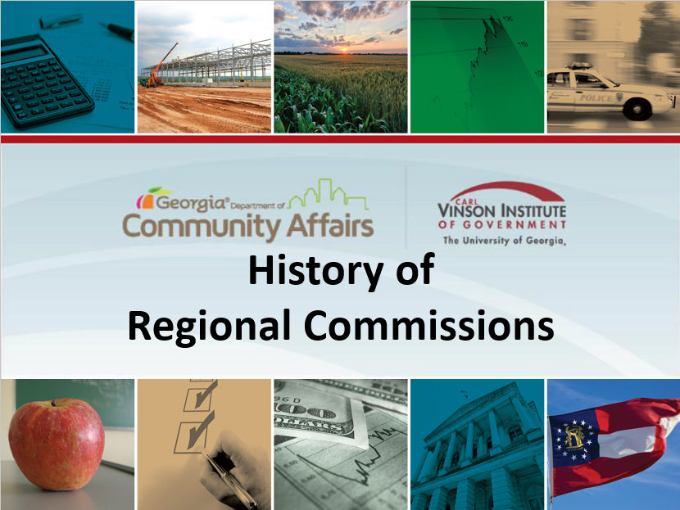
History of Regional Commissions
Introduction
1
See scree shot
Slide advances by user
Next = 2
On Screen Text:
History of Regional Commissions
In Georgia, Regional Commissions play an important part in comprehensive planning, land-use development, historic preservation, aging services, business retention and development, affordable housing, tourism, workforce development, coordinated transportation, geographic information systems, and disaster-mitigation planning. Congratulations and Thank You for the role you playing in making these commissions work for Georgia!

Slide 2

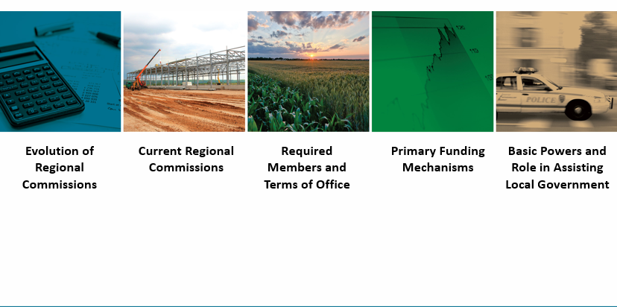
History of Regional Commissions
Lessons Overview
2
See screen shot
Slide advances by user
Previous = 1
Next = 3
On Screen Text:
What will you learn about in this module?
In this first module, you will walk through where regional commissions came from and why they exist. This should help you better understand how commissions help communicates, including where the money is coming from that commissions use and why it is important to be good stewards of that money. You will also take a look at what laws have dictated and changed regional commissions over time and recognize that what was once changed can change again. Five areas are included in this module and you will view them in order from the evolution of Regional Commissions to Basic Powers and Role in Assisting Local Government. So let’s get started!
Notes:
Home. Menu, Table of Contents or other?

Slide 3
History of Regional Commissions
Evolution of Regional Commissions Intro
3
Title Screen
Slide advances by user
Previous = 2
Next = 4
On Screen Text:
The Evolution of Regional Commissions in Georgia
First up will be a look at the history of regional commissions in Georgia from the 1960s to today.

Slide 4
History of Regional Commissions
1960s
4
Timeline graphic showing 1960 and 1969 as spots on the timeline
Additional graphics as desired
Slide advances by user
Previous = 3
Next = 5
On Screen Text:
  1960s
  Area Planning and Development Commissions (APDC)
  Regional Commissions began as APDCs or area planning and development commissions are were created in the early 1960s. Georgia was one of the first states where local governments worked together and used local monies for joint benefit to obtain professional resources and help.
  By 1969, there were 18 APDCs and nearly all of Georgia’s 159 counties had joined one.

Slide 5
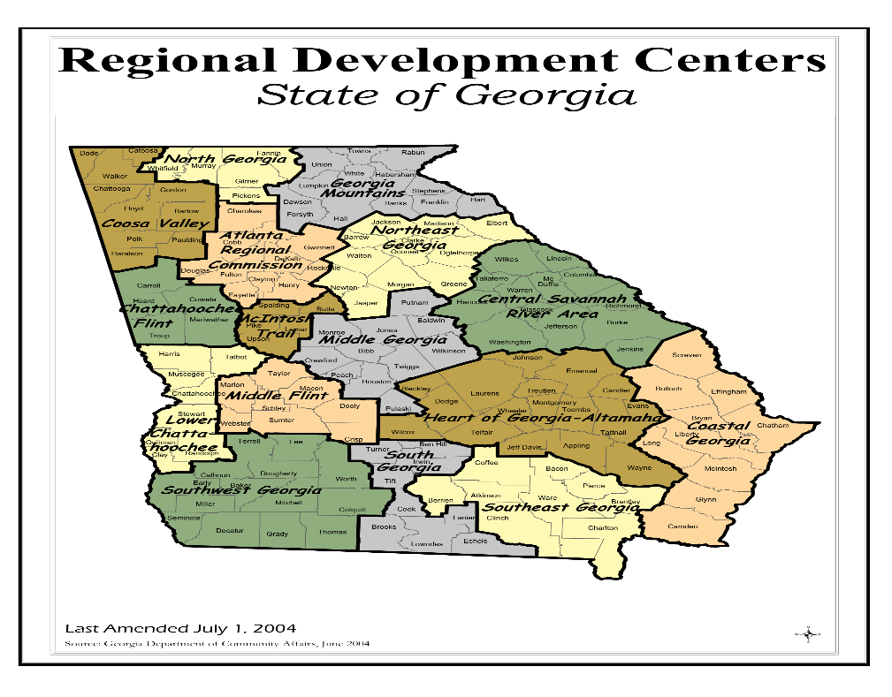
History of Regional Commissions
1980s
5
Timeline shows 1989 as a spot on the timeline
Map of RDCs
Additional graphics as desired
Slide advances by user
Previous = 4
Next = 6
On Screen Text:
  1980s
  Regional Development Centers (RDCs)
The Georgia Planning Act of 1989 gave the agencies the responsibility of coordinated and comprehensive planning statewide with funding provided by state and federal grants in addition to local dues. The APDCs became regional development centers or (RDCs) and number was reduced to 16.

Slide 6
History of Regional Commissions
2000s
7
Graphics as desired.
Slide advances by user
Previous = 6
Next = 8
On Screen Text:
2000s
Commission for a New Georgia Service Delivery Task Force
Government, private sector and community representatives
  Commissioner of Department of Community Affairs
  President of Georgia Association of Regional Development Centers
  State Senator
  State Representative
  City Mayors
  County Commissioners
  Local Attorneys
  Local business representatives
  Community leaders
Advisors to the Service Delivery Task Force
  Department of Community Affairs
  Fanning Institute at the University of Georgia
  Georgia Association of Regional Development Centers
  Association of County Commissioners of Georgia
  Georgia Municipal Association
  Governor’s office of Planning and Budget
  Governor’s Office of Implementation
House Bill 1216
In the late 2000s, as part of an overall effort to improve the business sector in Georgia, the Commission for a New Georgia Service Delivery Task Force delivered recommendations for the most recent changes to the RDC structure. The Service Delivery Task Force was represented and advised by government, private sector and community resources. This collection of representatives and advisors were instrumental in crafting the final legislation that resulted in House Bill 1216.

Slide 7
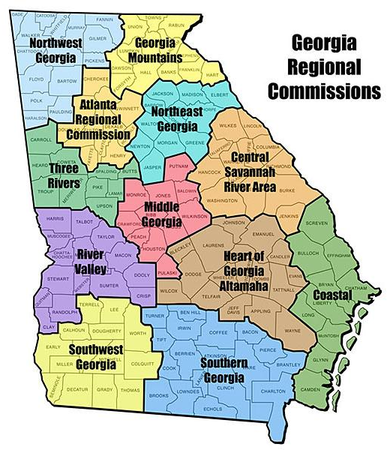
History of Regional Commissions
2000s
6
Timeline showing 2009 as spot on timeline
Map of 12 current commission regions
Slide advances by user
Previous = 5
Next = 7
On Screen Text:
    2000s
    Regional Commissions (RC)
    DCA
As a result of House Bill 1216, the RDCs became Regional Commissions and eight of the sixteen RDC regions were combined to form the current twelve RC regions. The goal was for all Regional Commissions to serve approximately the same population size. The one exception to this is the Atlanta Regional Commission which serves a significantly larger population. State law requires each county and city in Georgia be a member of the RC whose boundaries include these entities. The Georgia Department of Community Affairs provides oversight of the RCs and contracts annually with them to provide planning services to local governments.

Slide 8

History of Regional Commissions
Evolution Check for Understanding
8
Multiple Choice
Slide advances by user
Previous = 7
Next = 9
Submit
On Screen Text:
CheckPoint (title)
Select the correct answer from the choices given. Once you have selected an answer for all questions, click submit to see how you did.
Select the correct name, date, and # of counties in the formation of APDC.
Select the correct year, name, and # of regional commissions.
Select the correct year, name, and # of regional commissions.
Select each type of entity that served as advisors to and/or committees on the Service Delivery Task Force.
Time now to check your understanding of the Evolution of Regional Commissions in Georgia. For each question, select the correct answer from the choices given. Once you have selected an answer for all questions, click submit to see how you did.

Slide 9

History of Regional Commissions
Evolution Check Feedback
9
Present feedback
Slide advances by user
Previous = 8
Next = 10
On Screen Text:
How did you do?
PRESENT APPLICABLE FEEDBACK INCLUDING CORRECT ANSWER(S)
How did you do?

Slide 10
History of Regional Commissions
Current Regional Commissions Intro
10
Title Slide
Slide advances by user
Previous = 9
Next = 11
On Screen Text:
Regional Commissions
Next up is a closer look at the regional commissions and the counties that make up each commission.

Slide 11
History of Regional Commissions
Regional Commissions Map
11
Show map without Commissions names and have users click on a section to learn the name of the commission then keep the name displayed or something similar – some user interaction with the map. If you want to show specific commissions – available on http://garc.ga.gov/about-the-garc/
Slide advances by user
Previous = 10
Next = 12
On Screen Text:
State of Georgia Regional Commissions
All 159 counties in Georgia are part of one of twelve regional commissions throughout Georgia. Click on a region indicated on the map to see the names and locations of the current regional commissions.

Slide 12
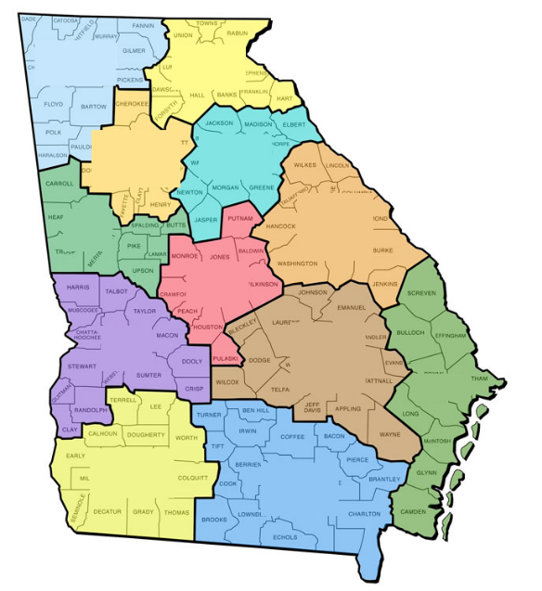
History of Regional Commissions
Map Check for Understanding
12
Present map of regions without the names and ask user to identify a commission on the map (drag and drop) or similar. Include 3 non-valid commission names in the list.
Slide advances by user
Previous = 11
Next = 13
Submit
On Screen Text:
CheckPoint.
Select the correct regional commission name for each of the twelve regions. Drag and drop the correct name to the applicable region.
Do you know the regional commissions now? Select the correct regional commission name for each of the twelve regions by dragging and dropping the correct name to the applicable region on the map. Note that there are 15 names to choose from but only 12 are correct names.

Slide 13
History of Regional Commissions
Map Check Feedback
13
Present feedback
Slide advances by user
Previous = 12
Next = 14
On Screen Text:
How did you do?
PRESENT APPLICABLE FEEDBACK INCLUDING CORRECT ANSWER(S)
How did you do?

Slide 14
History of Regional Commissions
Regional Commission Members Intro
14
Title Screen
Slide advances by user
Previous = 13
Next = 15
On Screen Text:
Regional Commission Members
Now let’s take a look at who the type and number of members are for each Regional Commission.

Slide 15
History of Regional Commissions
Georgia Code
15
Additional graphics as desired
Slide advances by user
Previous = 14
Next = 16
On Screen Text:
  Official Code of Georgia Annotated OCGA 50-8-34
  Required regional commission members are outlined in the Official Code of Georgia Annotated OCGA 50-8-34.

Slide 16
History of Regional Commissions
Required Members
16
Pie chart or other graphic to show make-up of commission by type of members. User has to click on type of member to see term served.
Slide advances by user
Previous = 15
Next = 17
On Screen Text:
Nonpublic member: A member who is not an employee, an elected official or an appointed official of any county or municipality.
Required Members (info to put in graphic)
Chief elected official of each member county (county chairperson) / concurrent with elected term
Elected officials from one municipality in each county / concurrent with elected term
Governor-appointed residents including school board member or superintendent / two years
Nonpublic member appointed by Lieutenant Governor / two years
Nonpublic member appointed by Speaker of the House / two years
Additional members if required to comply with laws or regulations / one year
First is a chief elected official of each county in the region. If unable to serve, he or she appoints another elected county official.
Next are elected officials from one municipality in each county..
There are also three residents of the region appointed by the Governor. One is a member of a school board located or a superintendent of schools within the region and two appointees are nonpublic council members. One nonpublic council member is appointed by the Lieutenant Governor.
One nonpublic council member appointed by the Speaker of the House of Representatives.
Finally, there may be additional members determined necessary by the Commissioner of Department of Community Affairs for purposes of complying with laws or regulations. Additional members such as this are selected by the council.
Notes:
Chief elected official of each member county (county chairperson) / concurrent with elected term
Elected officials from one municipality in each county / concurrent with elected term
Governor-appointed residents including school board member or superintendent / two years
Nonpublic member appointed by Lieutenant Governor / two years
Nonpublic member appointed by Speaker of the House / two years
Additional members if required to comply with laws or regulations / one year

Slide 17
History of Regional Commissions
Member Check for Understanding
17
Drag and drop
Slide advances by user
Previous = 16
Next = 18
Submit
On Screen Text:
CheckPoint
Select the correct code section that establishes the regional commission members.
Match elected official title with term years and correct appointment process and term years for non-elected members.
Time once again to check your understanding. This time we’ll check your understanding on the required members for regional commissions. Drag and drop the correct match or matches from the list on the right to the appropriate item or items on the left.
UPDATE AUDIO BASED ON HOW CONTENT IS PRESENTED AND INSTRUCTIONS NEEDED.

Slide 18
History of Regional Commissions
Required Members Check Feedback
18
Present feedback
Slide advances by user
Previous = 17
Next = 19
On Screen Text:
How did you do?
PRESENT APPLICABLE FEEDBACK INCLUDING CORRECT ANSWER(S)
How did you do?

Slide 19
History of Regional Commissions
FAQs on Membership
19
Slide advances by user
Previous = 18
Next = 20
On Screen Text:
Bonus Round
What process should be used for determining the Municipal members when a county has more than one city?
Can the Council have “proxy” members?
At this point, you may have some questions in mind about members. Two frequently asked questions are:
What process should be used for determining the Municipal members when a county has more than one city?
The law does not specify a particular process. Several scenarios have been suggested, a) The city that is the county seat of the county; b) The most populous city in the county; c) forming a committee of all the cities and let them determine a process and member; d) Rotating the member seat between cities; e) Nominations and voting with each city having one vote or proportioned by population; f) A caucus among the mayors to reach a consensus on the member. In addition, the law does not require that the same method of selecting municipal members be used consistently throughout the region.
Can the Council have “proxy” members?
The law does not make any provision for “proxy” members. If an attendance issue arises the by-laws often address this matter, if not then the appointing authority should be contacted regarding the problem.

Slide 20
History of Regional Commissions
Funding Intro
20
Title Screen
Slide advances by user
Previous = 19
Next = 21
On Screen Text:
Primary Funding Mechanisms
Funding allows Regional Commissions to provide valuable service to the communities they serve. What are the primary funding mechanisms for RCs?

Slide 21
History of Regional Commissions
Dues
21
Additional graphics as desired
Slide advances by user
Previous = 20
Next = 22
On Screen Text:
OCGA 50-8-33
Dues
Minimum of $.25 cents per resident
Funding for Regional Commissions is outlined in Official Code of Georgia Annotated OCGA 50-8-33. The RCs have two primary funding sources to support their regional services and operations. Counties and cities in the region must pay annual dues with dues equal to a minimum of $.25 cents for each resident. RCs often use the money from dues to match state and federal administrative grants in order to leverage larger monies available.

Slide 22
History of Regional Commissions
State Funds
22
Additional graphics as desired
Slide advances by user
Previous = 21
Next = 23
On Screen Text:
State Funds
Disbursed to RCs that collect $1 from each resident
Additional funding considered
Additionally, state funds are distributed to regional commissions by the Georgia Department of Community Affairs. The DCS established funding based on the state appropriation. In order to be eligible for minimum state funding, the RC from collect $1 from each resident. A Regional Commission may also apply to the DCA for supplemental state funding.

Slide 23
History of Regional Commissions
Funding Check for Understanding
23
.
Multiple choice
Slide advances by user
Previous = 22
Next = 24
Submit
On Screen Text:
CheckPoint
For each question, select the correct answer from the choices given. Once you have selected an answer for all questions, click submit to see how you did.
Select the correct code section for funding mechanism.
Select the correct funding mechanism.
Let’s do a quick review now on what you’ve learned about funding.

Slide 24
History of Regional Commissions
Funding Check Feedback
24
Present feedback
Slide advances by user
Previous = 23
Next = 25
On Screen Text:
How did you do?
PRESENT APPLICABLE FEEDBACK INCLUDING CORRECT ANSWER(S)
How did you do?

Slide 25
History of Regional Commissions
Role of Commission Intro
25
Title Screen
Slide advances by user
Previous = 24
Next = 26
On Screen Text:
Basic Powers and Role in Assisting Local Government
Economic development was at the heart of why commissions were created and why they continue on today. Regional commissions serve local governments through multicounty planning and development including monitoring population trends and recommending plans for coping with the demand on natural resources, transportation infrastructure and quality of life. In recent years, they have taken on other tasks such affordable housing, business development, aging services, disaster planning, historic preservation and tourism. For the last topic covered in this module, you will take an in-depth look at what a Regional Commission does and how they do it.

Slide 26
History of Regional Commissions
Role Overview
26
For each area, present list (see slides 27-29. Can present on one slide and have user click on graphic to see list or present across three slides where user interaction is required to view list or something similar.
Slide advances by user
Previous = 25
Next = 27
On Screen Text:
OCGA 50-8-35
What RCs do
Administer Commission
Research, Plan and Participate
Provide Services
Official Code of Georgia Annotated OCGA 50-8-35 delineates what each regional commission may do. The actions fall into three basic areas: Administering the Commission; Research, Planning and Participating; and Providing Services. To see specific actions that fall into each area, click on the area.
NOTE: UPDATE AUDIO BASED ON HOW CONTENT IS PRESENTED

Slide 27
History of Regional Commissions
Administer
27
See slide 26
Slide advances by user
Previous = 26
Next = 28
On Screen Text:
Administer Commission
  Adopt bylaws and make rules and regulations
  Provide benefits to its employees
  Each commission shall develop a department approved continuing education program for professional staff members of such commissions.
  Carry out such other programs as its council or the department shall require from time to time;
  Adopt personnel policies and practices
  Enter into contracts
    Chairperson of regional commission council and executive director of the RC must jointly execute such contracts
  Utilize services of Georgia Department of Administrative Services
  No Audio

Slide 28
History of Regional Commissions
Research, Plan and Participate
28
See slide 26
Slide advances by user
Previous = 27
Next = 29
On Screen Text:
Research, Plan and Participate
  Prepare studies of the area's resources for matters relating to area planning and development
  Collect, process, and analyze area social and economic statistics for planning purposes
  Coordinate and implement area research and development activities
  Coordinate area planning and development activities
  Undertake and carry out such planning and technical assistance activities for the development, preparation, and implementation of comprehensive plans for the commission's region and for municipalities and counties within the commission's region
  Compile a Georgia data base and network to serve as a comprehensive source of public information available to local governments, state agencies, and members of the General Assembly.
  Serve as liaison with other governments, including federal government agencies and state agencies, to administer state and federal programs
  No audio

Slide 29
History of Regional Commissions
Provide Services
29
See slide 26
Slide advances by user
Previous = 28
Next = 30
On Screen Text:
Provide Services
  Administer funds involving more than one political subdivision;
  Initiate, continue, or renew arrangements for the management, administration, or operation of human service programs by such regional commission.
    Cannot directly provide human service programs but may enter into contracts with other authorized entities, including units of local government, for the delivery of goods or services to provide assistance to and relieve the special burdens of the young, the indigent, the aged, persons with disabilities, the unemployed, or the ill.
  Acquire and dispose of real and personal property
  Enter into contracts to provide, or to provide directly with the council's approval, governmental services on behalf of the local governments.
    Chairperson of regional commission council and executive director of the RC must jointly execute such contracts
    Requires local government passing a resolution requesting such services and the council has approved the municipality's or county's resolution
    Contracts for direct services shall be for one year, subject to renewal
    Shall not provide direct services on a for profit basis
    Regional commissions shall be authorized to provide technical assistance to units of local government in areas of governmental services;
  Create or control or cause to be created any nonprofit corporation only for the purpose to administer federal or state revolving loan programs or housing and development programs
    Must be authorized by RC council and each affected local government
  No audio

Slide 30
History of Regional Commissions
Role Check for Understanding
30
.
Drag and drop
Slide advances by user
Previous = 29
Next = 31
Submit
On Screen Text:
CheckPoint
Select the correct code section that establishes the regional commission roles.
Select the correct regional commission roles.
Whew! RCs do a lot. Drag and drop the correct match or matches from the list on the right to the appropriate item or items on the left to check your understanding of what they do.
UPDATE AUDIO BASED ON HOW CONTENT IS PRESENTED AND INSTRUCTIONS NEEDED.
Notes:
For each question, drag and drop the correct answer from the choices given on the left to the question on the left. Once you have selected answered all questions, click submit to see how you did.

Slide 31
History of Regional Commissions
Role Check Feedback
31
Present feedback
Slide advances by user
Previous = 30
Next = 32
On Screen Text:
How did you do?
PRESENT APPLICABLE FEEDBACK INCLUDING CORRECT ANSWER(S)
How did you do?

Slide 32
History of Regional Commissions
FAQs on Role
32
Slide advances by user
Previous = 31
Next = 33
On Screen Text:
Bonus Round
If a Regional Commission is approached about contracting with one of its member local government (or governments) to provide ‘direct services’ to the public does DCA have to approve?
Can one Regional Commission contract for services with another Regional Commission?
Does the selection of a Regional Commission Executive Director have to be approved by DCA?
Bonus Round time. Let’s take a look at a few questions you may have on the role of the commissions
If a Regional Commission is approached about contracting with one of its member local government (or governments) to provide ‘direct services’ to the public does DCA have to approve?
No, the commission is permitted to enter into contracts to provide, or to provide directly with the council’s approval, governmental services on behalf of the local governments. Direct services are provided only after such municipality or county has passed a resolution requesting such services and the council has approved the municipality’s or county’s resolution. Contracts are for one year, subject to renewal.
Can one Regional Commission contract for services with another Regional Commission?
Yes. The law affords quite a bit of latitude in contracting with the exception of human services. The law specifically states that each commission “… may contract with another commission to provide services for the benefit of one or both commissions.”
Does the selection of a Regional Commission Executive Director have to be approved by DCA?
No. It is the responsibility of the Council of the Regional Commission to select an Executive Director who is appointed and removed by a majority vote of the members.
.

Slide 33
History of Regional Commissions
Wrap Up
33
Additional graphic as desired.
Slide advances by user
Previous = 32
Next = 34
On Screen Text:
Thank you!
http://www.georgiaencyclopedia.org/articles/government-politics/regional-commissions-georgia
http://www.georgiaencyclopedia.org/articles/government-politics/regional-commissions-georgia#
This concludes your tour of the history of Georgia’s regional commissions. Thank you for your time. Please check out these resources for more information on Regional Commissions.

